Slide 1

Analysis and Forecasting :
U.S. On-Highway Diesel Fuel Prices (1994–2024)
Presented by,
Group 7
Date,
4th December 2024
Lakshmy Cherussery Jayaprakash
Michael Lanotte
Anjelina Sajan
Rakshitha Vignesh Sargurunathan

Slide 2

INTRODUCTION
Timeframe:
April 1994 to October 2024 (monthly frequency)
Dataset :
U.S. On-Highway Diesel Fuel Prices
(Source : U.S. Energy Information Administration)
Key Metrics:
Diesel price per gallon ($), ranging from $0.959 to $5.754
Source & Context:
Captures average monthly prices, critical for economic and transportation insights.

Slide 3

RATIONALE FOR DATASET SELECTION
Diesel prices impact transportation costs, shipping rates, and consumer goods prices.
Highlights economic trends, market dynamics, and price shocks.
Relevant for policy makers, forecasters, and industry professionals.

Slide 4
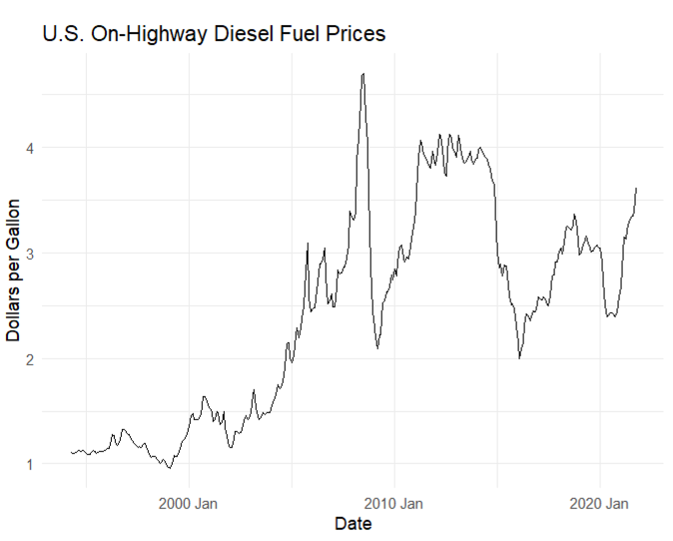
TIME SERIES PLOT
The time series plot illustrates the overall trend of diesel prices over three decades, showing significant spikes and periods of volatility.
Notable peak around 2008, corresponding to the global financial crisis and its impact on fuel prices.
A steep decline during 2014–2016, coinciding with the oil price crash.
Prices rebound post-2020, influenced by market recovery after the COVID-19 pandemic.

Slide 5
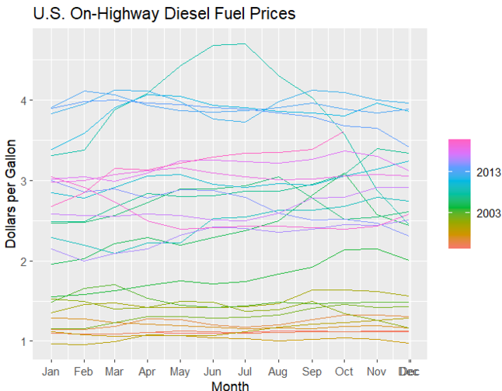
SEASONAL PLOT
The seasonal plot highlights recurring patterns in diesel prices, with higher prices typically observed in the summer months.
Prices typically rise during summer months (June–August).
Slight dip observed in fall (September–October).
Increased volatility during winter months (November–February).
Patterns repeat yearly with variations in intensity.
Reflects demand cycles and external economic factors.

Slide 6
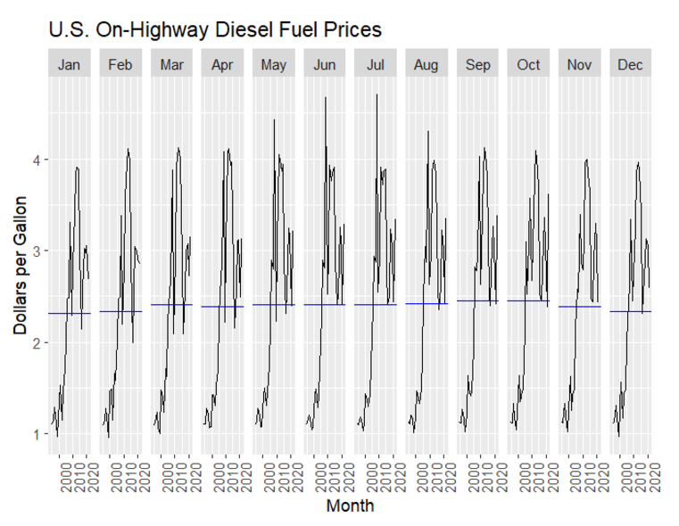
MONTHLY BREAKDOWN OF PRICES
While seasonal trends are consistent, the baseline price increases over the decades, reflecting inflation and market factors.

Slide 7
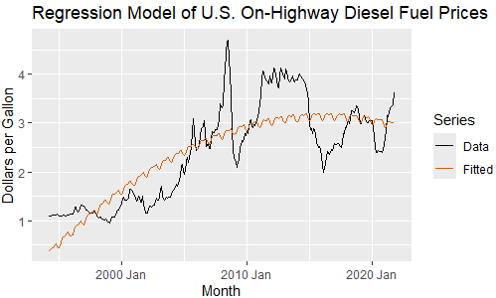
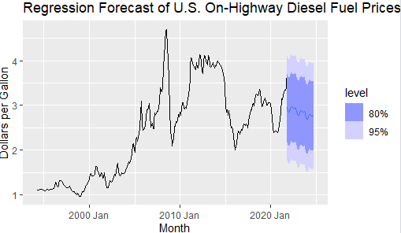
TIME SERIES REGRESSION MODEL
Model includes seasonality and quadratic trend
Low p-value (2.2e-16) suggests statistical significance
R-squared= 0.58 - model explains 58% of the variation

Slide 8
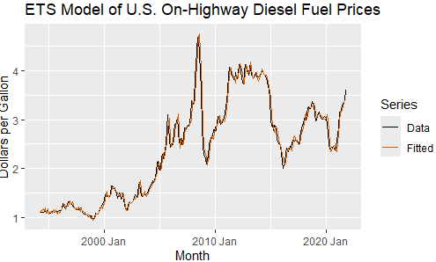
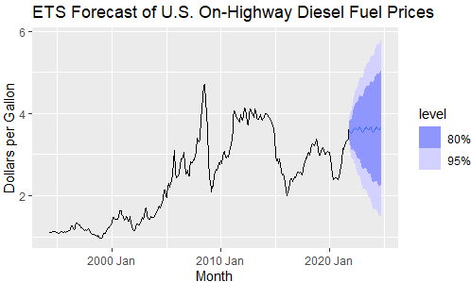
MANUAL ETS MODEL
Trend is increasing at a diminishing rate
There is some seasonality, but it’s unclear if it is additive or multiplicative
Error could be additive or multiplicative
Best model: Multiplicative error, additive damped trend, additive seasonality
AIC = 439.93

Slide 9
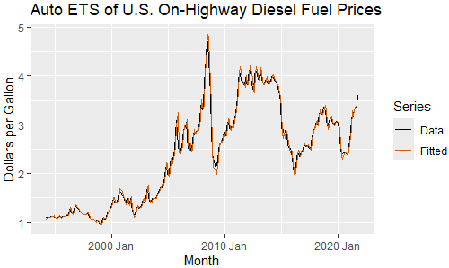
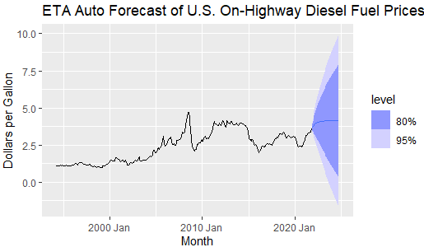
AUTO ETS MODEL
Multiplicative error, additive damped trend, and no seasonality
AIC = 339.38
Similar to our manual ETS, except without any seasonality
Lower AIC but larger confidence intervals than the manual ETS

Slide 10
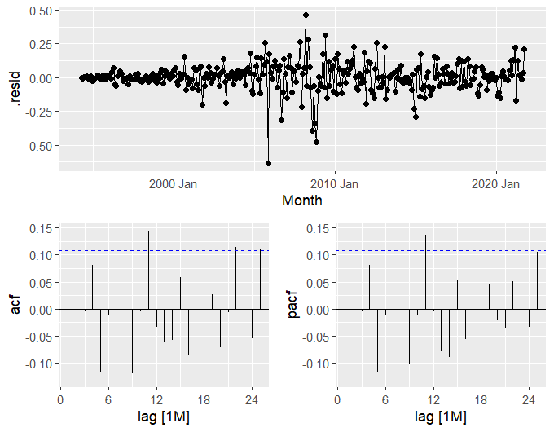
ARIMA MODELING PROCESS
Model Diagnostics for ARIMA(1,1,1)
Residuals show random variation around zero, confirming no systematic pattern.
ACF and PACF indicate no significant autocorrelation, validating the model fit.
These diagnostics confirm the adequacy of ARIMA(1,1,1) for the data.

Slide 11
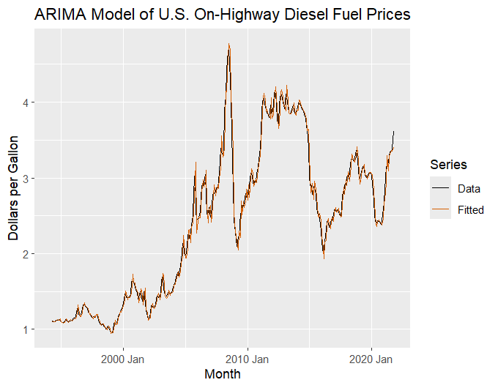
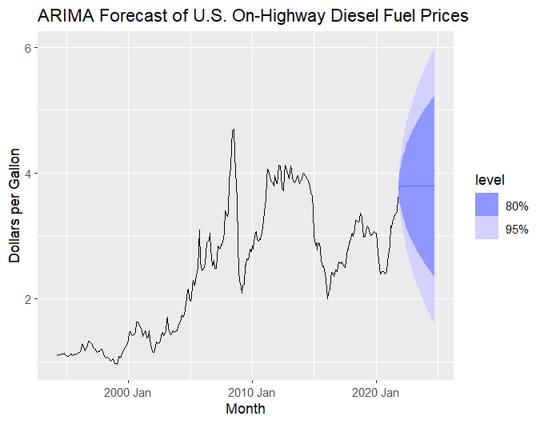
ARIMA MODEL FIT AND FORECAST
The ARIMA(1,1,1) model captures major trends and fluctuations in diesel prices over time, including periods of sharp increases and declines.
Forecast shows price trends with quantified uncertainty through prediction intervals.

Slide 12
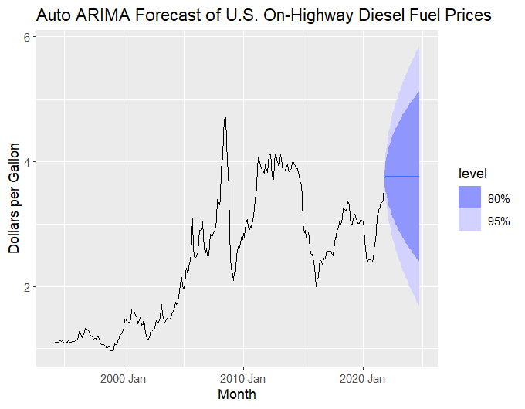
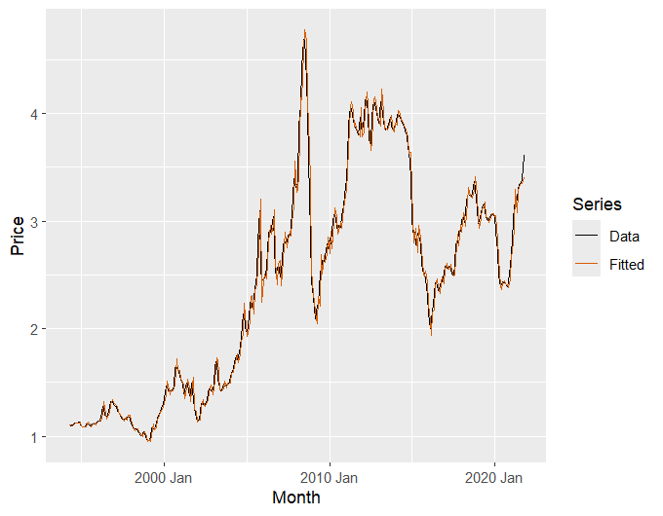
ARIMA(0,1,2) USING AUTO.ARIMA() MODEL FIT AND FORECAST
Selected ARIMA(0,1,2) over ARIMA(1,1,1) because it had a slightly lower AIC value (-543.65 vs. -543.61), indicating a better model fit with reduced complexity, while maintaining similar residual diagnostics and forecast accuracy.

Slide 13
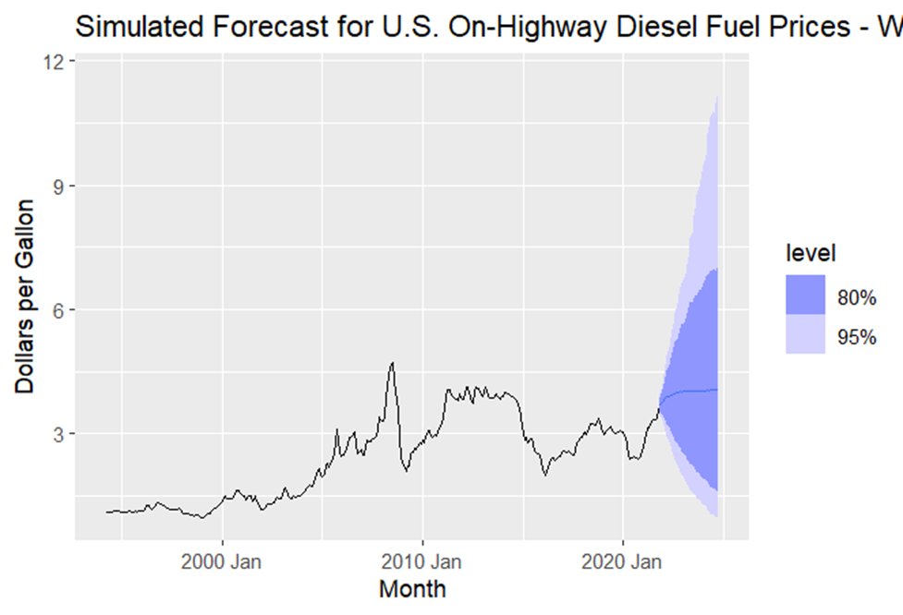
ENSEMBLE APPROACH
Created weighted combination model using:
Regression model (TSLM)
ETS (automated)
ARIMA (automated)
Used inverse variance (RMSE-based) weighting
Generated 1000 simulation paths for prediction intervals
Enabled capturing strengths of multiple approaches

Slide 14
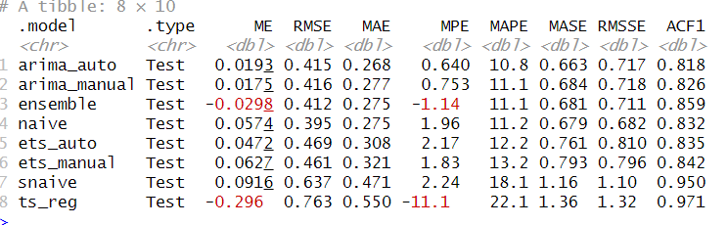
CROSS-VALIDATION RESULTS & MODEL COMPARISON
The ensemble model is the best overall due to its balance of low error (RMSE = 0.412, MAE = 0.275) and improved bias correction (MPE = -1.14), making it robust for accurate directional forecasting.
While the naive model has the lowest RMSE (0.395) and ties with the ensemble model for the lowest MAE (0.275), the ARIMA_auto model slightly outperforms ETS_auto in accuracy with lower MAE (0.268 vs. 0.308) and MAPE (10.8 vs. 11.2). The ts_reg model performs the worst with the highest RMSE (0.763), MAE (0.550), and MAPE (22.1).

Slide 15
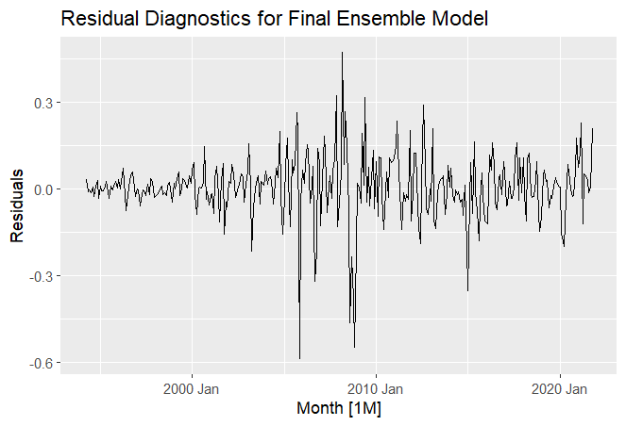
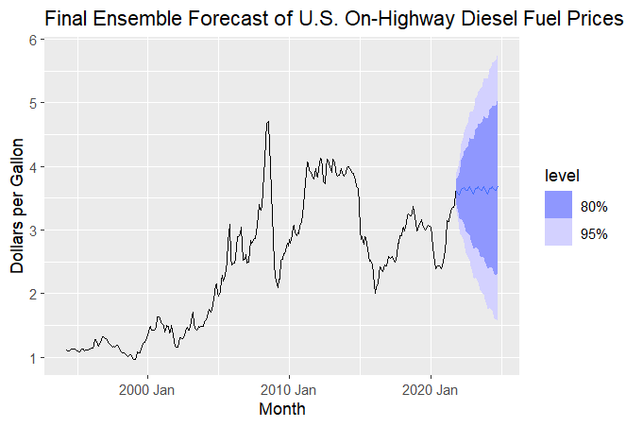
FINAL MODEL SELECTION
Final Model: ENSEMBLE MODEL
Robustness to Volatility: The ensemble model's combination of predictions enhances stability against unpredictable fuel price factors, making it a reliable forecasting choice.
Lowest RMSE: With an RMSE of 0.412, the ensemble model outperforms the next best model, arima_auto (RMSE 0.415), indicating superior accuracy.
Competitive MAE: The ensemble's MAE of 0.275 matches the naive model and outperforms others, showing effective error minimization.
Consistent MAPE: The ensemble's MAPE of 11.1% aligns with arima_manual, indicating reliable performance across data scales.
Strong ACF1: An ACF1 of 0.859 suggests the ensemble effectively captures temporal dependencies better than other models.

Slide 16
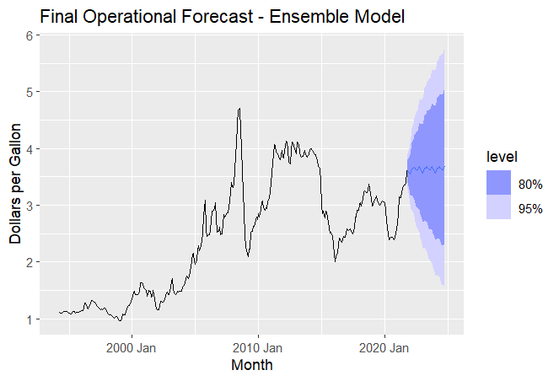
OPERATIONAL FORECAST
Operational 36-Month Forecast
Historical peak ~$5 in 2010, followed by sustained $4 level
Strong recovery from 2020 dip ($2) to current $3.5+
Model projects upward trend toward $4
Widening uncertainty bands suggest growing market volatility
Reliability: Most accurate within first 12 months.

Slide 17
FUTURE DIRECTIONS & RECOMMENDATIONS
Model Enhancement Opportunities:
Continuous Improvement Plan:
Current Limitations:
Pattern stability assumptions
External shock sensitivity
Fixed weighting structure
Integrate external market indicators
Develop hybrid forecasting approaches
Implement dynamic response mechanisms
Monthly model retraining
Quarterly accuracy assessments
Ongoing methodology refinement

Slide 18


THANK YOU

Slide 19
APPENDIX: MODEL DEVELOPMENT AND PROCEDURES
Detailed methodologies and evaluations supporting our forecast models.

Slide 20

TIME SERIES REGRESSION PROCEDURE
Objective: Model the trend and seasonality in diesel prices using regression.
Methodology:
Data Preprocessing:
Reviewed data for completeness and consistency.
Applied logarithmic transformation to stabilize variance, later reverted to the original scale for interpretability.
Trend Identification:
Analyzed scatter plots and identified a quadratic trend, suggesting prices increase at a varying rate.
Seasonality Detection:
Seasonal decomposition indicated higher prices during summer months, aligning with historical demand patterns.
Model Specification:
Built a regression model including both linear and quadratic trend terms, along with monthly dummy variables to capture seasonality:
Evaluation Metrics:
R-squared: 0.58, indicating that 58% of the variation is explained by the model.
Statistical Significance: p-value < 0.001 (2.2e-16), confirming strong model reliability.
Residual Analysis:
Residuals exhibited no major autocorrelation, indicating an adequately specified model.
Reference: Regression analysis results in the main presentation highlight the accuracy and significance of the model. (Slides 6-7)

Slide 21
MANUAL ETS MODEL
Objective: Develop an Exponential Smoothing State Space (ETS) model manually to understand trend and seasonality dynamics.
Methodology:
Trend and Seasonality Analysis:
Identified an increasing trend, diminishing over time.
Seasonality patterns suggested an additive approach but required testing against multiplicative components.
Model Exploration Process:
Evaluated different combinations of error types (additive vs. multiplicative), trend, and seasonality.
Selected the M,Ad,A model (Multiplicative Error, Additive Damped Trend, Additive Seasonality).
Model Evaluation:
AIC Value: 439.93. While slightly higher than the automated model, it retained seasonality.
Residual Check:
Residuals showed randomness, indicating no significant patterns or bias.
Reference: The ETS analysis in the manual process is detailed on slides 8, providing a comparative performance assessment.

Slide 22
AUTO ETS PROCEDURE
Objective: Use R’s automated ETS selection for efficient model fitting and comparison.
Methodology:
Automation Process: Applied ets() function in R, which optimizes error, trend, and seasonality components.
Model Selection:
Chosen model: Multiplicative error, Additive damped trend, No seasonality (M,Ad,N).
Evaluation Metrics:
AIC Value: 339.38 (significantly lower than the manual ETS model).
Model Complexity: Absence of seasonality simplifies interpretation but may affect long-term accuracy.
Key Consideration: While the lower AIC indicates better fit, the lack of seasonality could overlook important cyclical patterns in fuel prices.
Reference: Comparative results for the manual vs. automated ETS models are discussed on slides 9.

Slide 23
ARIMA PROCEDURE
Objective: Identify the most accurate ARIMA model for diesel price forecasting.
Methodology:
Stationarity Check:
Conducted an Augmented Dickey-Fuller (ADF) test, confirming that differencing was needed to achieve stationarity.
Model Identification:
Analyzed ACF and PACF plots to determine appropriate ARIMA orders:
Initial model: ARIMA(1,1,1).
Model Diagnostics:
Checked residuals to ensure no autocorrelation, indicating a good fit.
Compared models using AIC:
ARIMA(0,1,2): Selected due to a slightly lower AIC (-543.65) compared to ARIMA(1,1,1) (-543.61).
Final Model Justification:
Simpler structure with comparable accuracy.
Robust in capturing trends and volatility in diesel prices.
Reference: Detailed ARIMA diagnostics and comparisons are presented on slides 10-12.

Slide 24
ENSEMBLE MODEL PROCEDURE
Objective: Combine multiple models to leverage their strengths and improve overall forecast accuracy.
Methodology:
Model Components:
Time Series Regression (TSLM), Auto ETS (M,Ad,N), and ARIMA(0,1,2).
Weighting Approach:
Applied inverse variance weighting based on Root Mean Square Error (RMSE) from cross-validation results.
Simulation:
Generated 1,000 simulation paths to construct robust prediction intervals.
Performance Evaluation:
Ensemble approach reduced overall forecast error by capturing diverse model strengths.
Reference: Ensemble model construction and results are outlined on slides 15-16.

Slide 25
CROSS-VALIDATION RESULTS
1. Cross-Validation Design
Cross-validation was performed using a rolling-origin technique with the following configuration:
Initialization: The first 60 observations from the training set were used as the initial window.
Step Size: Each iteration increased the training window by 12 observations.
Forecast Horizon: Models were evaluated for a forecast horizon of 12 steps.
KEY OBSERVATION:
The automatic ARIMA model achieved the lowest MAPE (10.8%) and RMSE (0.415), making it the most accurate for diesel price forecasting.
Ensemble Approach: Despite slightly higher MAPE (11.1%) and RMSE (0.412), the ensemble model showed competitive performance, indicating the value of combining diverse models for enhanced reliability.
Naïve and SNaïve Models: These baseline models performed surprisingly well for MAPE (11.2% for Naïve), highlighting the importance of comparing complex models with simple benchmarks.
ETS Models: Both manual and automatic ETS models had higher error metrics, suggesting that exponential smoothing did not adequately capture the data's characteristics.
TSLM Model: With the highest MAPE (22.1%) and RMSE (0.763), this model struggled to handle non-linear trends and seasonality effectively.
Reference: Cross-validation details and comparative metrics are on slides 13

Slide 26
MODEL SELECTION JUSTIFICATION Objective: To select the most suitable forecasting model based on performance metrics, robustness, and practical considerations for diesel price forecasting.
1. Model Selection Process
The final model was selected to enhance forecast accuracy and address residual issues noted during cross-validation. The Enhanced Ensemble Model combines forecasts from multiple individual models with inverse variance weighting to prioritize models with lower forecast errors. This approach ensures robustness by integrating diverse modeling methodologies.
Weighting: The combination model uses inverse variance weighting (cmbn_args = list(weights = "inv_var")), emphasizing more reliable models with lower variance.
3. Residual Diagnostics
Residual diagnostics were performed to evaluate the model's adequacy and verify assumptions.
3.1 Residual Plot:
The residuals showed a random scatter around zero, indicating no discernible patterns or bias in predictions.
3.2 Autocorrelation (ACF) Plot:
Autocorrelations in residuals were analyzed up to 24 lags. Significant spikes were observed, suggesting minor autocorrelation issues in some lags.
3.3 Residual Histogram:
The histogram revealed a bell-shaped distribution with slight deviations from normality. This was further quantified through normality testing.
3.4 Ljung-Box Test:
Statistic: 65.0
p-value: 0.000000614 The test results indicate that residuals exhibit statistically significant autocorrelation, necessitating potential refinement of model parameters.
3.5 Shapiro-Wilk Test:
W-statistic: 0.89964
p-value: 5.488e-14 The test confirms non-normality in residuals, although this is common in time series models and does not invalidate the forecasts.
4. Key Insights from Diagnostics
Residual Autocorrelation: While minor autocorrelation remains, it is unlikely to materially impact forecast accuracy due to the ensemble's diversified model contributions.
Residual Distribution: Non-normality, as indicated by the Shapiro-Wilk test, suggests possible outliers or heteroskedasticity. These issues could be addressed with further modeling enhancements if required.
Inverse Variance Weighting: The applied weighting ensures that individual model biases are mitigated, leveraging strengths across all combined models.

Slide 27
Why ENSEMBLE METHOD?
Improved Forecast Accuracy: The ensemble approach combines forecasts from multiple models, leveraging the strengths of each. This integration reduces the impact of individual model biases or weaknesses, resulting in more accurate and reliable forecasts.
Robustness Against Model Misspecification: By including diverse modeling techniques (e.g., ARIMA, ETS, and TSLM), the ensemble mitigates the risk of relying solely on an incorrectly specified or underperforming model. This ensures the model adapts well to various data patterns, including trends, seasonality, and irregularities.
Variance Reduction: Using inverse variance weighting in the ensemble prioritizes models with lower forecast errors, ensuring that predictions are more stable and less sensitive to outliers or anomalies in the dataset. This reduces overall forecast uncertainty and enhances model performance.
Reference: Slides 15-16 provide comparative metrics and visual diagnostics.
FINAL MODEL SELECTION: ARIMA(0,1,2)

Slide 28
OPERATIONAL FORECAST IMPLEMENTATION
The Final Operational Forecast was generated using the Enhanced Ensemble Model, projecting diesel prices over a 36-month horizon. The forecast integrates predictions from ARIMA, ETS, and TSLM models, utilizing inverse variance weighting to prioritize models with higher reliability.
Key Insights from the Forecast
Historical Context:
Diesel prices peaked at approximately $5 per gallon in 2010, followed by a sustained period around the $4 per gallon level.
A sharp dip occurred in 2020, reaching a low of $2 per gallon during the global economic downturn, followed by a strong recovery to the current level of $3.50+ per gallon.
Forecasted Trend:
The model projects a gradual upward trend toward the $4 per gallon mark over the forecast period. This aligns with historical patterns of market recovery and economic growth.
Uncertainty and Volatility:
The forecast's uncertainty bands widen over the 36-month horizon, indicating increased market volatility in the long term. This reflects potential variability due to external factors like geopolitical events, supply chain disruptions, and policy changes.
Forecast Reliability
Short-term Accuracy: The model demonstrates the highest reliability within the first 12 months of the forecast, where confidence intervals are narrower and align closely with recent historical trends.
Long-term Projections: Beyond 12 months, the widening uncertainty bands suggest reduced confidence, emphasizing the need for continuous model monitoring and re-evaluation
Practical Implications
The operational forecast serves as a valuable tool for planning and decision-making, helping stakeholders anticipate future price movements and manage risks effectively. It highlights the need for proactive strategies to address potential market volatility, especially beyond the short-term horizon.

Slide 29
Conclusion: Navigating the Future of Diesel Prices
Over the past three decades, diesel prices have reflected the complex interplay of economic growth, global disruptions, and market recovery. From the 2008 financial crisis to the recent post-pandemic rebound, the data underscores both the resilience and volatility of this essential commodity.
Our analysis revealed distinct seasonal trends and a long-term upward trajectory, driven by increased demand during summer months and broader market adjustments. Leveraging an Enhanced Ensemble Model, which integrates ARIMA, ETS, and TSLM methodologies, we have developed a robust forecast for diesel prices over the next three years.
Key Takeaways for the Future
Short-Term Insights:
Diesel prices are projected to rise moderately, with forecasted values ranging between $2.50 and $5.50 per gallon.
The model demonstrates high accuracy within the first 12 months, providing reliable guidance for immediate decision-making.
Market Dynamics:
While steady growth is anticipated, the widening uncertainty bands highlight potential external shocks, such as supply chain disruptions, geopolitical events, or policy shifts, which could introduce volatility.
Practical Applications:
This forecast serves as a critical tool for businesses, policymakers, and consumers to:
Optimize transportation budgets.
Refine pricing strategies.
Prepare for market fluctuations effectively.
Actionable Insights for Stakeholders
Our journey through the data highlights the importance of forecasting in transforming uncertainty into actionable insights. By combining historical trends with advanced modeling techniques, this approach empowers stakeholders to navigate the complexities of tomorrow’s fuel market with enhanced confidence. Continuous monitoring and model updates will ensure that the forecast remains a reliable guide in an ever-evolving market landscape.

